Slide 1



Data Structure
&
Algorithm
Class IX
lab 10

Slide 2

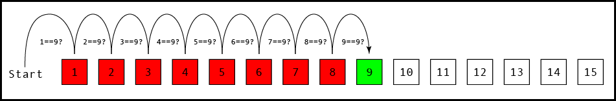
Linear Search
a very simple search algorithm

Slide 3
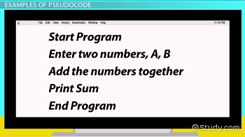
Pseudocode
helps to create algorithm

Slide 4
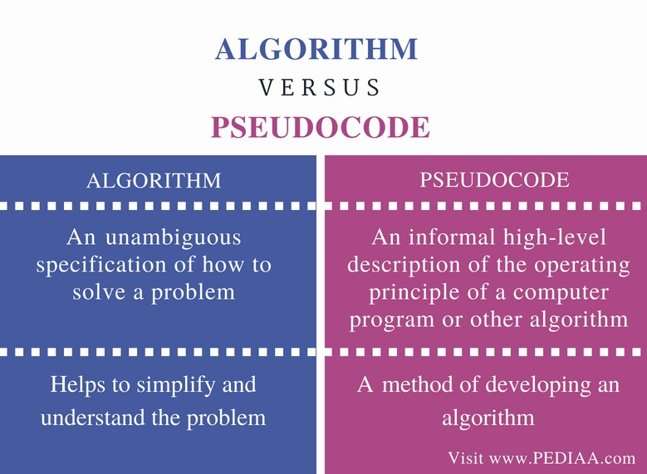

Slide 5
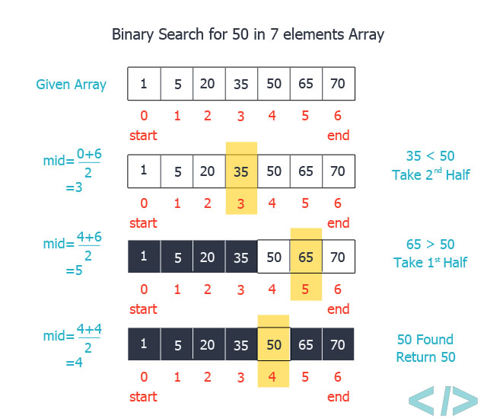
Binary Search

Slide 6
Binary Search

Slide 7


